Slide 1
Deep Learning Based Speech Separation
DeLiang Wang
Perception & Neurodynamics Lab
Ohio State University
& Northwestern Polytechnical University
http://www.cse.ohio-state.edu/pnl/

Slide 2
Outline of presentation
Introduction
Training targets
Features
Separation algorithms
Concluding remarks

Slide 3
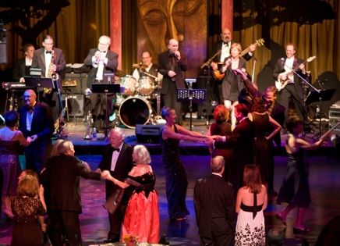
Real-world audition
What?
Speech
message
speaker
age, gender, linguistic origin, mood, …
Music
Car passing by
Where?
Left, right, up, down
How close?
Channel characteristics
Environment characteristics
Room reverberation
Ambient noise
Notes:
3

Slide 4

Sources of intrusion and distortion
additive noise from
other sound sources
channel distortion
reverberation from
surface reflections
Notes:
4

Slide 5
Cocktail party problem
Term coined by Cherry
“One of our most important faculties is our ability to listen to, and follow, one speaker in the presence of others. This is such a common experience that we may take it for granted; we may call it ‘the cocktail party problem’…” (Cherry’57)
“For ‘cocktail party’-like situations… when all voices are equally loud, speech remains intelligible for normal-hearing listeners even when there are as many as six interfering talkers” (Bronkhorst & Plomp’92)
Ball-room problem by Helmholtz
“Complicated beyond conception” (Helmholtz, 1863)
Speech separation problem
Separation and enhancement are used interchangeably when dealing with nonspeech interference
Notes:
5

Slide 6
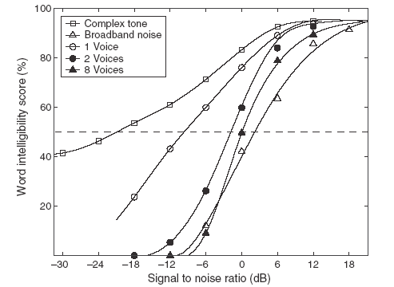
Human performance in different interferences
SRT 23 dB difference in Speech Reception
Threshold!
Source: Wang & Brown (2006)
Notes:
6
don’t comment at this point on the effect of competing speakers

Slide 7
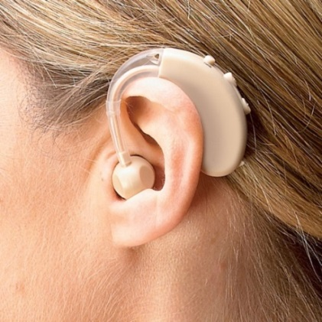
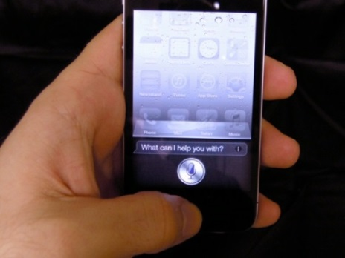
Some applications of speech separation
Robust automatic speech and speaker recognition
Noise reduction for hearing prosthesis
Hearing aids
Cochlear implants
Noise reduction for mobile communication
Audio information retrieval

Slide 8
Traditional approaches to speech separation
Speech enhancement
Monaural methods by analyzing general statistics of speech and noise
Require a noise estimate
Spatial filtering with a microphone array
Beamforming
Extract target sound from a specific spatial direction with a sensor array
Independent component analysis
Find a demixing matrix from multiple mixtures of sound sources
Computational auditory scene analysis (CASA)
Based on auditory scene analysis principles
Feature-based (e.g. pitch) versus model-based (e.g. speaker model)
Notes:
8

Slide 9
Supervised approach to speech separation
Data driven, i.e. dependency on a training set
Born out of CASA
Time-frequency masking concept has led to the formulation of speech separation as a supervised learning problem
A recent trend fueled by the success of deep learning
Focus of this tutorial
Notes:
9

Slide 10
Ideal binary mask as a separation goal
Motivated by the auditory masking phenomenon and auditory scene analysis, we suggested the ideal binary mask as a main goal of CASA (Hu & Wang’04)
The idea is to retain parts of a mixture where the target sound is stronger than the acoustic background, and discard the rest
The definition of the ideal binary mask (IBM)
θ: A local SNR criterion (LC) in dB, which is typically chosen to be 0 dB
Optimal SNR: Under certain conditions the IBM with θ = 0 dB is the optimal binary mask in terms of SNR gain (Li & Wang’09)
Maximal articulation index (AI) in a simplified version (Loizou & Kim’11)
It does not actually separate the mixture!

Slide 11
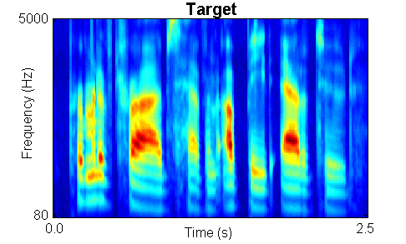
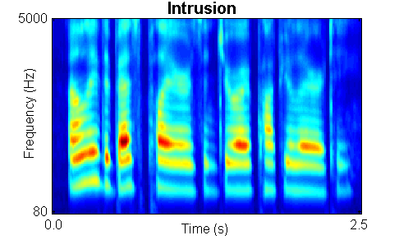

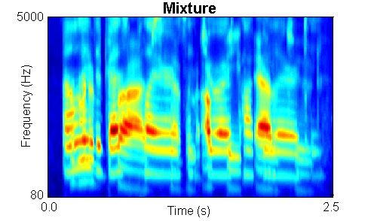
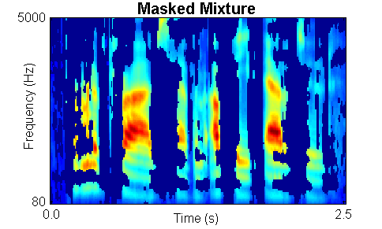
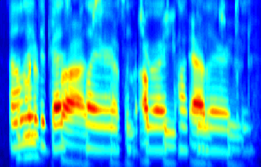
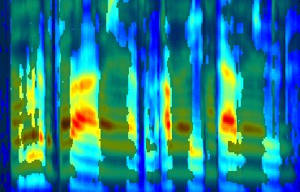
IBM illustration

Slide 12
Subject tests of ideal binary masking
IBM separation leads to large speech intelligibility improvements
Improvement for stationary noise is above 7 dB for normal-hearing (NH) listeners (Brungart et al.’06; Li & Loizou’08; Cao et al.’11; Ahmadi et al.’13), and above 9 dB for hearing-impaired (HI) listeners (Anzalone et al.’06; Wang et al.’09)
Improvement for modulated noise is significantly larger than for stationary noise
With the IBM as the goal, the speech separation problem becomes a binary classification problem
This new formulation opens the problem to a variety of pattern classification methods
Notes:
Brungart and Simpson (2001)’s experiments show coexistence of informational and energetic masking.
They have also isolated informational masking using across-ear effect when listening to two talkers in one ear experience informational masking from third signal in the opposite ear (Brungart and Simpson, 2002)
Arbogast et al. (2002) divide speech signal into 15 log spaced, envelope modulated sinewaves. Assign some to target and some to interference: intelligible speech with no spectral overlaps

Slide 13
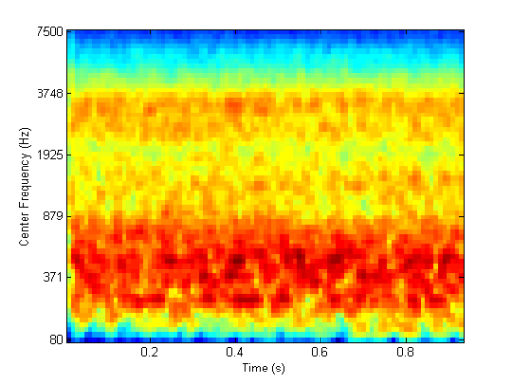

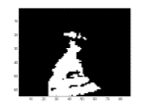
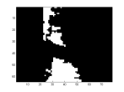
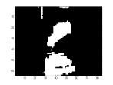
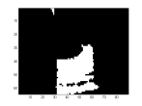
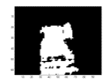
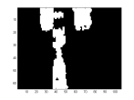
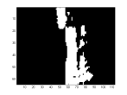
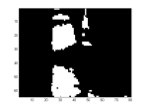
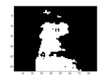
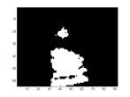
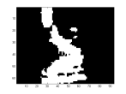
Speech perception of noise with binary gains
Wang et al. (2008) found that, when LC is chosen to be the same as the input SNR, nearly perfect intelligibility is obtained when input SNR is -∞ dB (i.e. the mixture contains noise only with no target speech)
IBM modulated noise for ???
Speech shaped noise
Notes:
Create a continuous noise signal that match long-term average spectrum of speech
Further approach to divide “speech-spectrum-shaped” noise into number of bands and modulate with natural speech envelopes
However, noise signal too “speech-like” and reintroduce informational masking (Brungart et al. 2004)
Alternatively, use Ideal Binary Mask to remove informational masking
Eliminate portions of stimulus dominated by the interfering speech.
Retain only portions of target speech acoustically detectable in the presence of interfering speech

Slide 14
Deep neural networks
Why deep?
As the number of layers increases, more abstract features are learned and they tend to be more invariant to superficial variations
Superior performance in practice if properly trained (e.g., convolutional neural networks)
Deep structure is harder to train
Vanishing gradients: Error derivatives tend to become very small in lower layers
Restricted Boltzmann machines (RBMs) can be used for unsupervised pretraining
However, RBM pretraining is not needed with large training data

Slide 15
Different DNN architectures
Feedforward networks
Multilayer perceptrons (MLPs) with at least two hidden layers
With or without RBM pretraining
Convolutional neural networks (CNNs)
Cascade of pairs of convolutional and subsampling layers
Invariant features are coded through weight sharing
Backpropagation is the standard training algorithm
Recurrent networks
Backpropagation through time is commonly used for training recurrent neural networks (RNNs)
To alleviate vanishing or exploding gradients, LSTM (long short-term memory) introduces memory cells with gates to facilitate the information flow over time

Slide 16
Part II: Training targets
What supervised training aims to learn is important for speech separation/enhancement
Different training targets lead to different mapping functions from noisy features to separated speech
Different targets may have different levels of generalization
While the IBM is first used in supervised separation (see Part IV), many training targets have since been used
Notes:
16

Slide 17
Different training targets
TBM (Kjems et al.’09; Gonzalez & Brookes’14) is similar to the IBM except that interference is fixed to speech-shaped noise (SSN)
IRM (Srinivasan et al.’06; Narayanan & Wang’13; Wang et al.’14; Hummersone et al.’14)
S and N denote speech and noise
β is a tunable parameter, and a good choice is 0.5
With β = 0.5, the IRM becomes a square root Wiener filter, which is the optimal estimator of the power spectrum

Slide 18
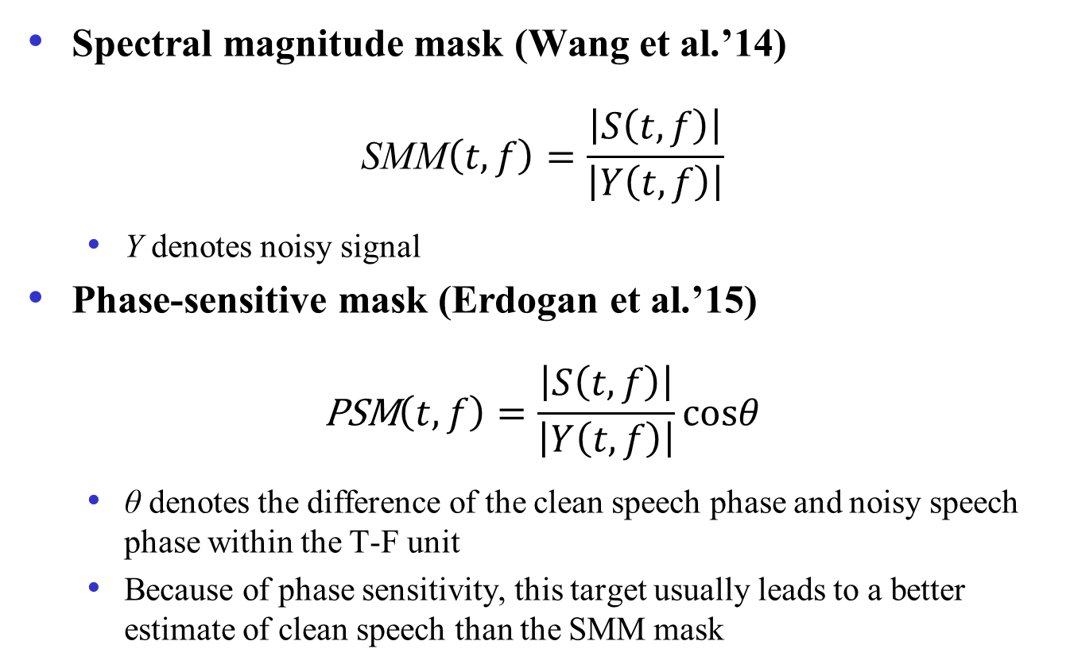
Different training targets (cont.)
Spectral magnitude mask (Wang et al.’14)
$$\text{SMM}\left(t,f\right)=\frac{\left|S\left(t,f\right)\right|}{\left|Y\left(t,f\right)\right|}$$
Y denotes noisy signal
Phase-sensitive mask (Erdogan et al.’15)
$$\text{P}\text{SM}\left(t,f\right)=\frac{\left|S\left(t,f\right)\right|}{\left|Y\left(t,f\right)\right|}cosθ$$
θ denotes the difference of the clean speech phase and noisy speech phase within the T-F unit
Because of phase sensitivity, this target usually leads to a better estimate of clean speech than the SMM mask

Slide 19
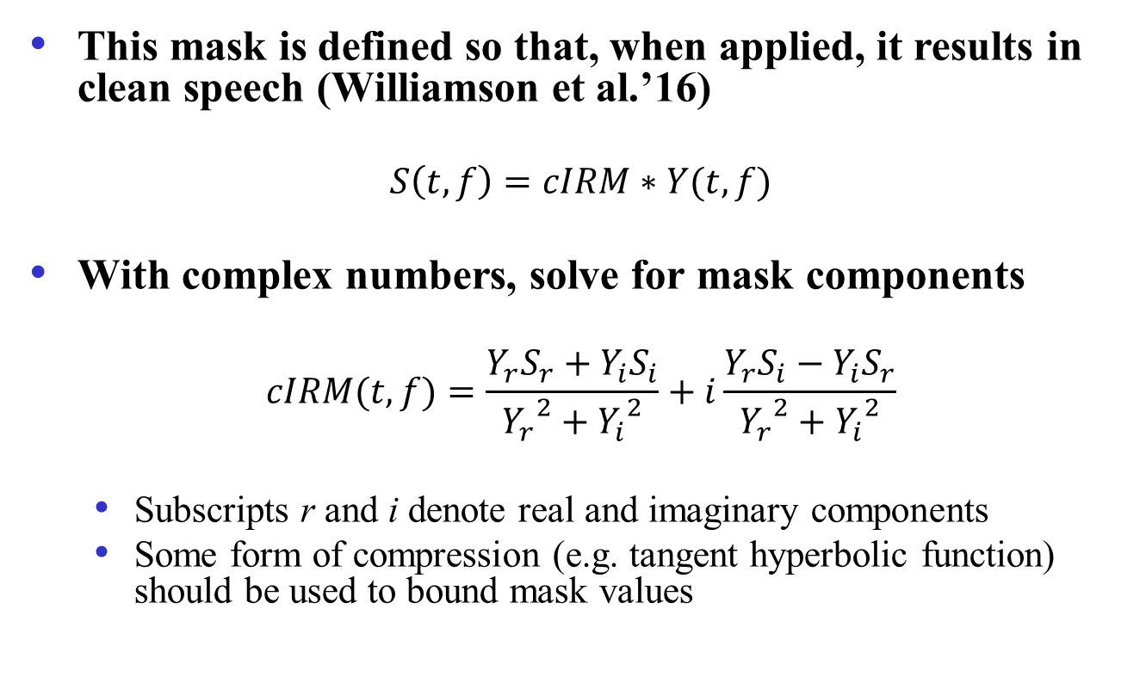
Complex Ideal Ratio Mask (cIRM)
This mask is defined so that, when applied, it results in clean speech (Williamson et al.’16)
$$S\left(t,f\right)=cIRM∗Y(t,f)$$
With complex numbers, solve for mask components
$$cIRM(t,f)=\frac{Y_{r}S_{r}+Y_{i}S_{i}}{{Y_{r}}^{2}+{Y_{i}}^{2}}+i\frac{Y_{r}S_{i}−Y_{i}S_{r}}{{Y_{r}}^{2}+{Y_{i}}^{2}}$$
Subscripts r and i denote real and imaginary components
Some form of compression (e.g. tangent hyperbolic function) should be used to bound mask values

Slide 20
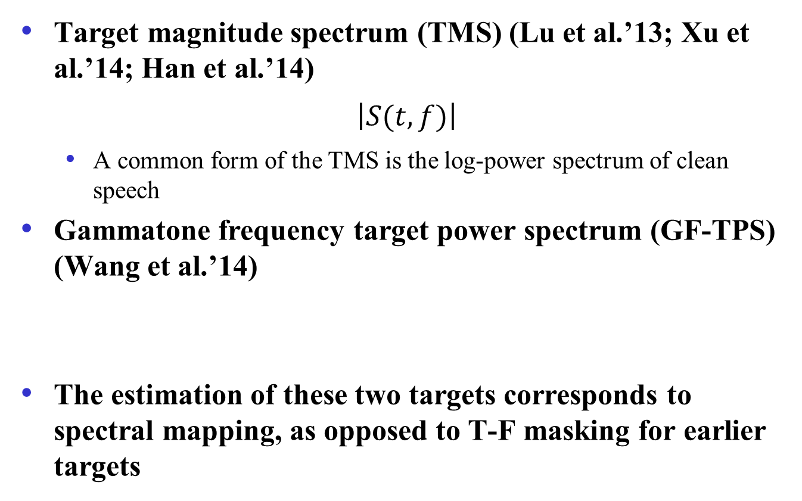
Different training targets (cont.)
Target magnitude spectrum (TMS) (Lu et al.’13; Xu et al.’14; Han et al.’14)
$$\left|S(t,f)\right|$$
A common form of the TMS is the log-power spectrum of clean speech
Gammatone frequency target power spectrum (GF-TPS) (Wang et al.’14)
The estimation of these two targets corresponds to spectral mapping, as opposed to T-F masking for earlier targets

Slide 21
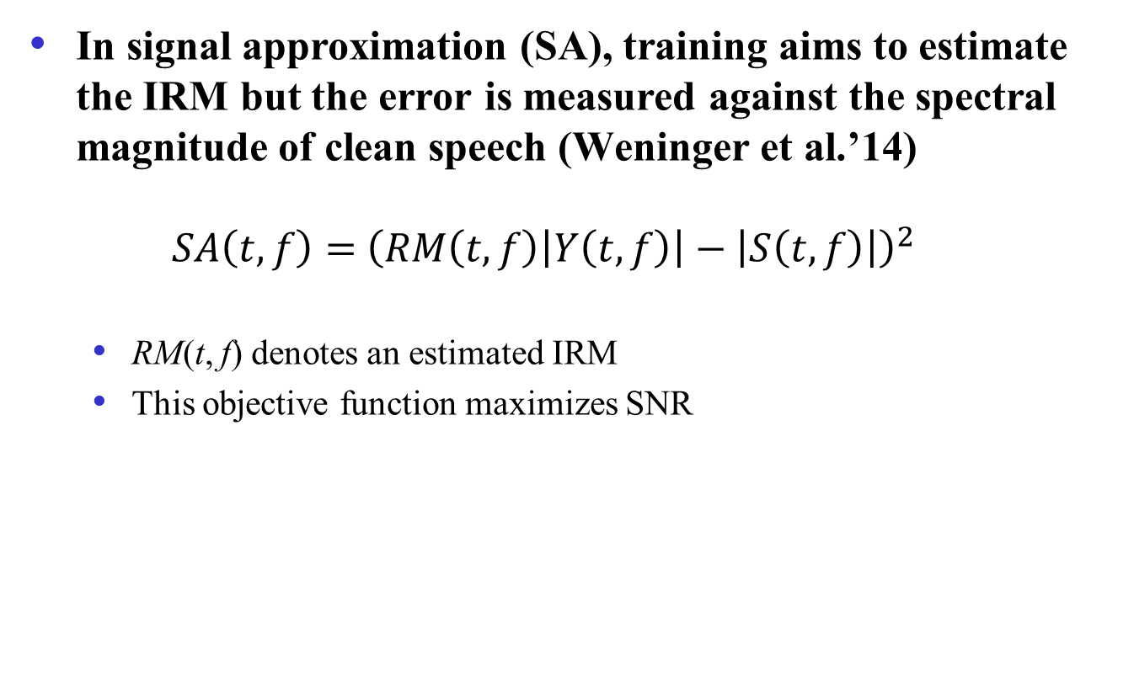
Signal approximation
In signal approximation (SA), training aims to estimate the IRM but the error is measured against the spectral magnitude of clean speech (Weninger et al.’14)
$$SA\left(t,f\right)={ \left(RM\left(t,f\right)\left|Y\left(t,f\right)\right|−\left|S\left(t,f\right)\right|\right)}^{2}$$
RM(t, f) denotes an estimated IRM
This objective function maximizes SNR

Slide 22
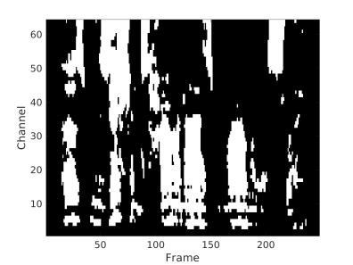
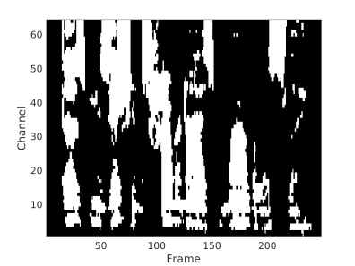
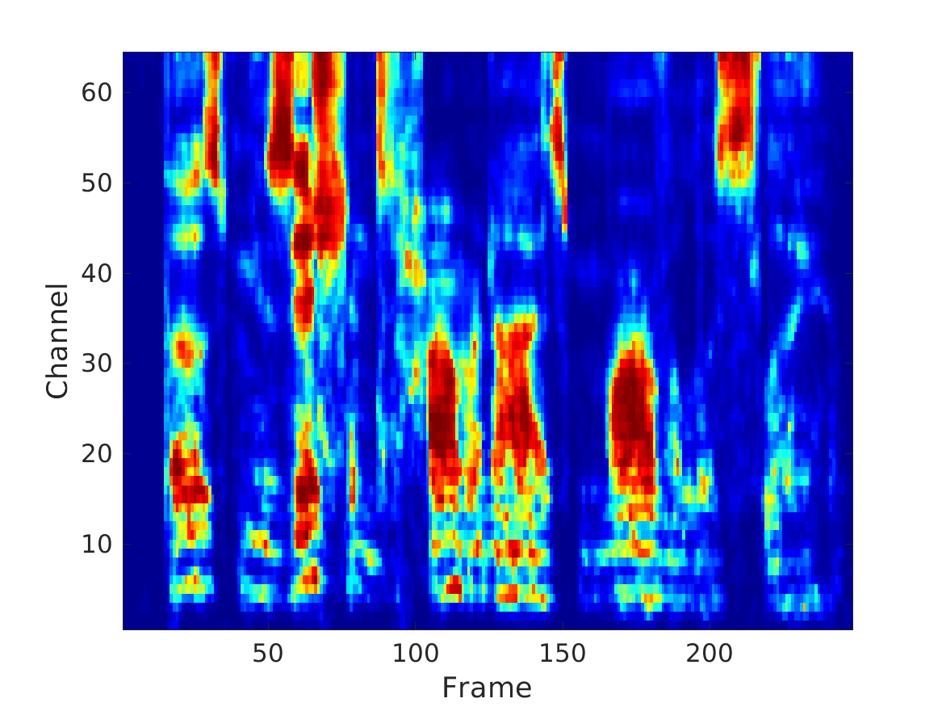
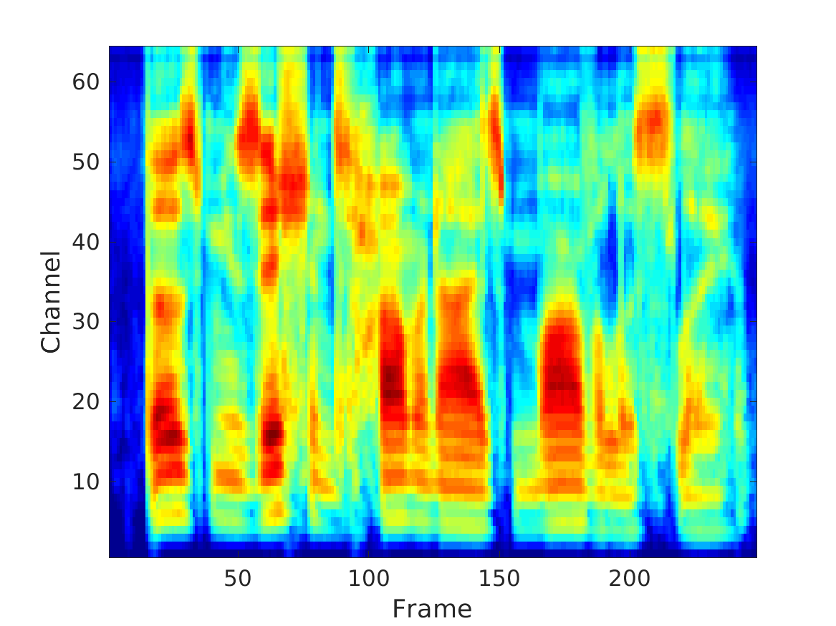
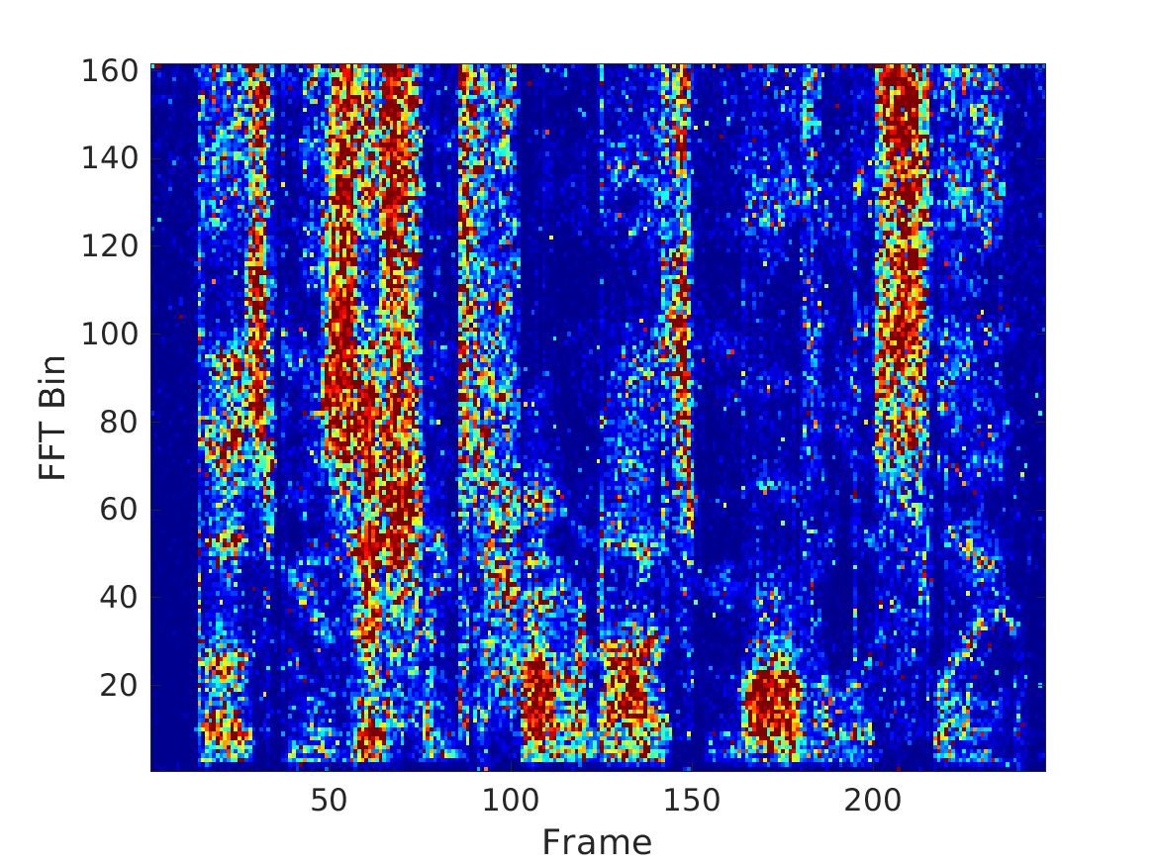
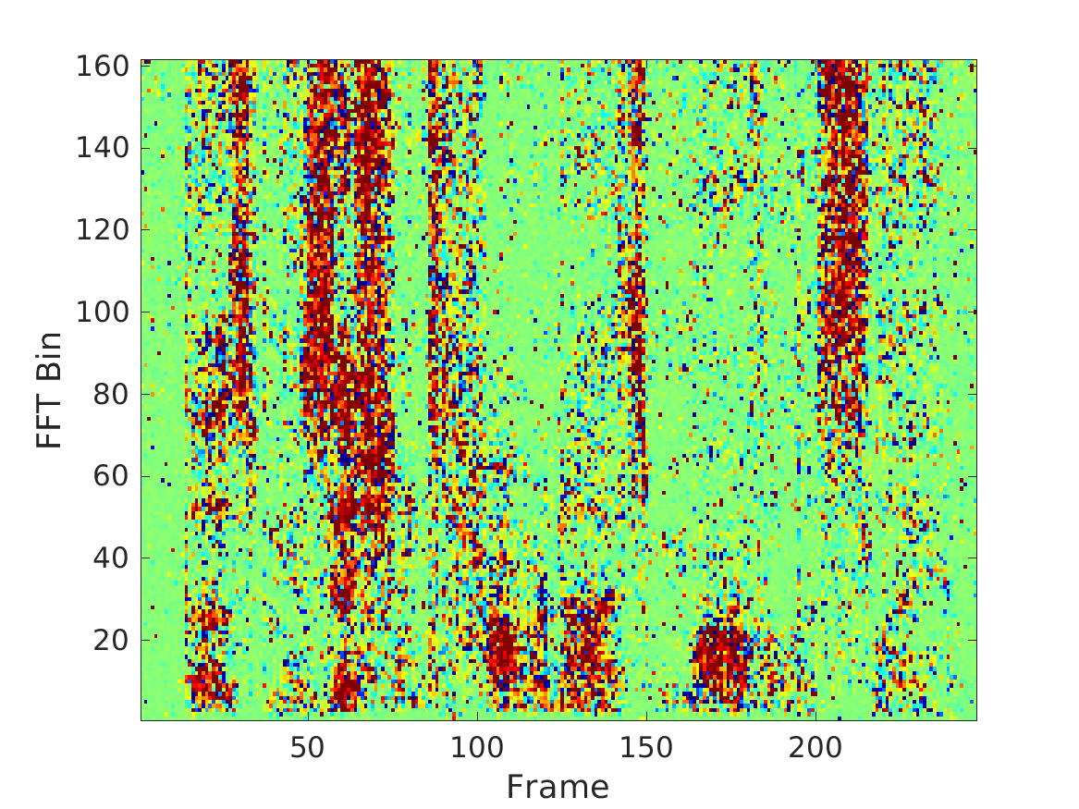
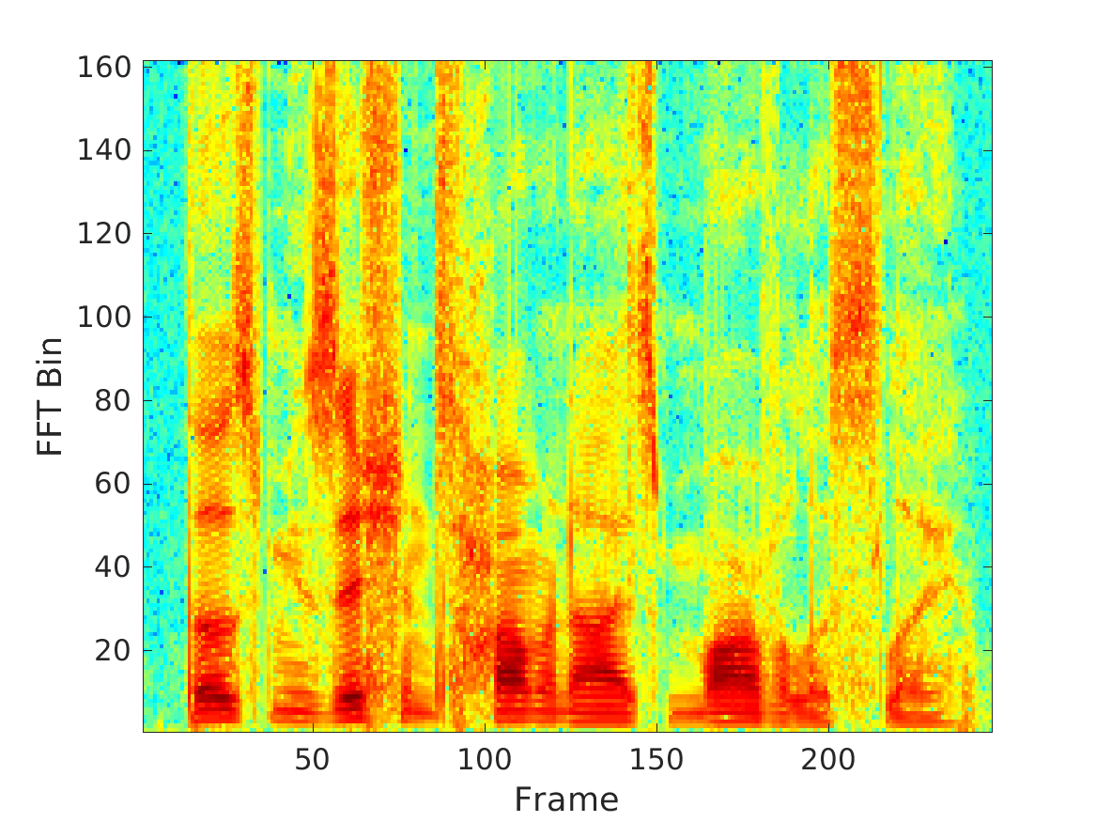
Illustration of various training targets
(a) IBM (b) TBM (c) IRM (d) GF-TPS
(e) SMM (f) PSM (g) TMS
Factory noise at -5 dB

Slide 23
Evaluation of training targets
Wang et al. (2014) studied and evaluated a number of training targets using the same DNN with 3 hidden layers, each with 1024 units
Other evaluation details
Target speech: TIMIT
Noises: SSN + four nonstationary noises from NOISEX
Training and testing on different segments of each noise
Trained at -5 and 0 dB, and tested at -5, 0, and 5 dB
Evaluation metrics
STOI: standard metric for predicted speech intelligibility
PESQ: standard metric for perceptual speech quality
SNR

Slide 24
Comparisons
Comparisons among several different training targets
An additional comparison for the IRM target with multi-condition (MC) training of all noises (MC-IRM)
Comparisons with different approaches
Speech enhancement (SPEH) (Hendriks et al.’10)
Supervised NMF: ASNA-NMF (Virtanen et al.’13), trained and tested in the same way as supervised DNN separation

Slide 25
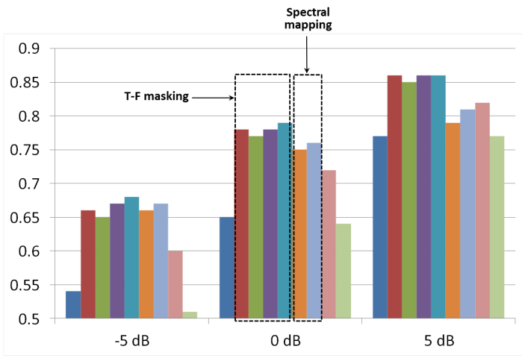
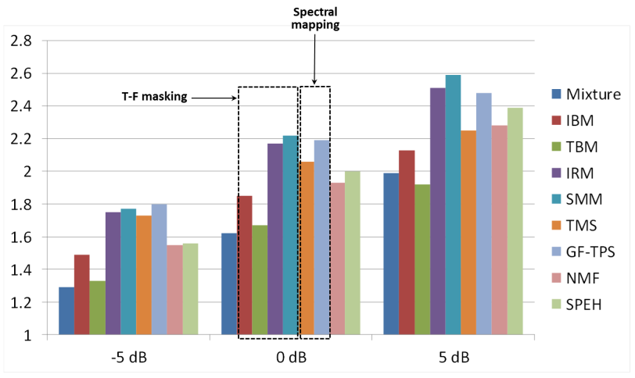
STOI comparison for factory noise

Slide 26
PESQ comparison for factory noise

Slide 27
Summary among different targets
Among the two binary masks, IBM estimation performs better in PESQ than TBM estimation
Ratio masking performs better than binary masking for speech quality
IRM, SMM, and GF-TPS produce comparable PESQ results
SMM is better than TMS for estimation
Many-to-one mapping in TMS vs. one-to-one mapping in SMM, and the latter should be easier to learn
Estimation of spectral magnitudes or their compressed version tends to magnify estimation errors

Slide 28
Part III: Features for supervised separation
For supervised learning, features and learning machines are two key components
Early studies only used a few features
ITD/ILD (Roman et al.’03)
Pitch (Jin & Wang’09)
Amplitude modulation spectrogram (AMS) (Kim et al.’09)
Subsequent studies expanded the list
A complementary set is recommended: AMS+RASTA-PLP+MFCC (Wang et al.’13)
A new feature, called MRCG (multi-resolution cochleagram), is found to be discriminative (Chen et al.’14)

Slide 29
A systematic feature study
Extending Chen et al. (2014), Delfarah and Wang (2017) recently conducted a feature study that considers room reverberation and both speech enhancement and speaker separation
Evaluation done at the low SNR level of -5 dB, with implications for speech intelligibility improvements

Slide 30
Evaluation framework
Each frame of features is sent to a DNN to estimate the IRM

Slide 31
Features selected for evaluation
Features examined before include GF (gammatone frequency), GFCC (Shao et al.’08), GFMC, AC-MFCC, RAS-MFCC, PAC-MFCC, PNCC (Kim & Stern’12), GFB, and SSF
In addition, newly studied ones include
Log spectral magnitude (LOG-MAG)
Log mel-spectrum (LOG-MEL)
Waveform signal (WAV)

Slide 32
STOI improvements (%)

Slide 33
Result summary
Best performing features are MRCG, PNCC, and GFCC under different conditions
Gammatone-domain features (MRCG, GF and GFCC) perform strongly
Modulation-domain features do not perform well
Waveform signal without any feature extraction is not a good feature
The most effective feature sets:
PNCC, GF, and LOG-MEL for speech enhancement
PNCC, GFCC, and LOG-MEL for speaker separation

Slide 34
Part IV. Separation algorithms
Monaural separation
Speech-nonspeech separation
Speaker separation
Separation of reverberant speech
Multi-channel separation
Spatial feature based separation
Masking based beamforming
Notes:
34

Slide 35
Early monaural attempts at IBM estimation
Jin & Wang (2009) proposed MLP-based classification to separate reverberant voiced speech
A 6-dimensional pitch-based feature is extracted within each T-F unit
Classification aims at the IBM, but with a training target that takes into account of the relative energy of the T-F unit
Kim et al. (2009) proposed GMM-based classification to perform speech separation in a masker dependent way
AMS features are extracted within each T-F unit
First monaural speech segregation algorithm to achieve speech intelligibility improvement for NH listeners

Slide 36
DNN as subband classifier
Y. Wang & Wang (2013) first introduced DNN to address the speech separation problem
DNN is used for as a subband classifier, performing feature learning from raw acoustic features
Classification aims to estimate the IBM

Slide 37
DNN as subband classifier

Slide 38
Extensive training with DNN
Training on 200 randomly chosen utterances from both male and female IEEE speakers, mixed with 100 environmental noises at 0 dB (~17 hours long)
Six million fully dense training samples in each channel, with 64 channels in total
Evaluated on 20 unseen speakers mixed with 20 unseen noises at 0 dB
DNN based classifier produced the state-of-the-art separation results at the time

Slide 39
Speech intelligibility evaluation
Healy et al. (2013) subsequently evaluated the classifier on speech intelligibility of hearing-impaired listeners
A very challenging problem: “The interfering effect of background noise is the single greatest problem reported by hearing aid wearers” (Dillon’12)
Two stage DNN training to incorporate T-F context in classification

Slide 40
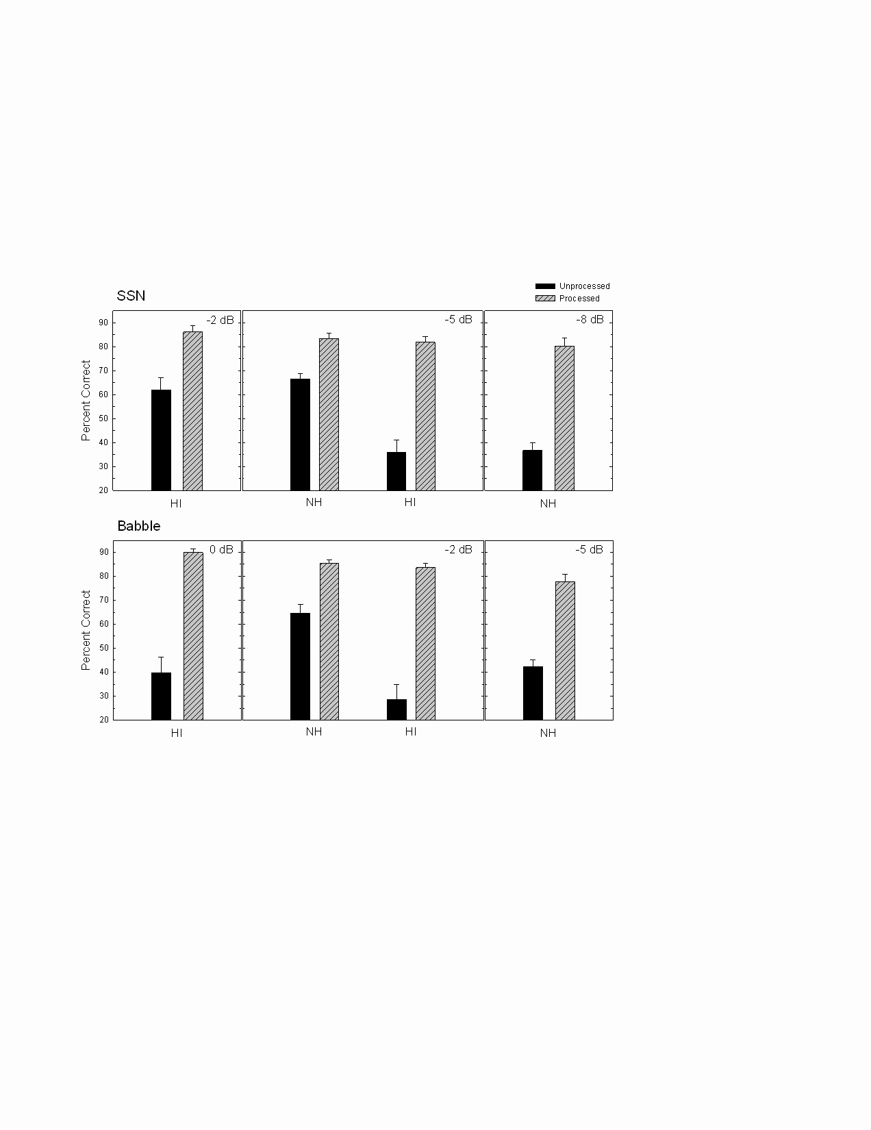

Results and sound demos
Both HI and NH listeners showed intelligibility improvements
HI subjects with separation outperformed NH subjects without separation

Slide 41
Generalization to new noises
While previous speech intelligibility results are impressive, a major limitation is that training and test noise samples were drawn from the same noise segments
Speech utterances were different
Noise samples were randomized
This limitation can be addressed through large-scale training for IRM estimation (Chen et al.’16)

Slide 42
Large-scale training
Training set consisted of 560 IEEE sentences mixed with 10,000 (10K) non-speech noises (a total of 640,000 mixtures)
The total duration of the noises is about 125 h, and the total duration of training mixtures is about 380 h
Training SNR is fixed to -2 dB
The only feature used is the simple T-F unit energy (GF)
DNN architecture consists of 5 hidden layers, each with 2048 units
Test utterances and noises are both different from those used in training

Slide 43
STOI performance at -2 dB input SNR
 | Babble | Cafeteria | Factory | Babble2 | Average
Unprocessed | 0.612 | 0.596 | 0.611 | 0.611 | 0.608
100-noise model | 0.683 | 0.704 | 0.750 | 0.688 | 0.706
10K-noise model | 0.792 | 0.783 | 0.807 | 0.786 | 0.792
Noise-dependent model | 0.833 | 0.770 | 0.802 | 0.762 | 0.792
DNN model with large-scale training provides similar results to noise-dependent model

Slide 44
DNN as spectral magnitude estimator
Xu et al. (2014) proposed a DNN-based enhancement algorithm
DNN (with RBM pretraining) is trained to map from log-power spectra of noisy speech to those of clean speech
More input frames and training data improve separation results

Slide 45
Xu et al. results in PESQ
With trained noises
Subscript in DNN denotes number of hidden layers
With two untrained noises (A: car; B: exhibition hall)

Slide 46
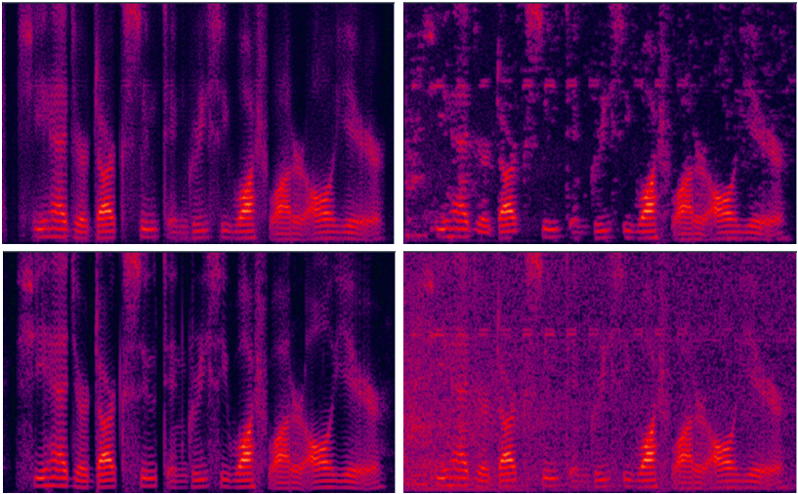
Xu et al. demo
Street noise at 10 dB (upper left: DNN; upper right: log-MMSE; lower left: clean; lower right: noisy)

Slide 47
Part IV. Separation algorithms
Monaural separation
Speech-nonspeech separation
Speaker separation
Separation of reverberant speech
Multi-channel separation
Spatial feature based separation
Masking based beamforming
Notes:
47

Slide 48
DNN for two-talker separation
Huang et al. (2014; 2015) proposed a two-talker separation method based on DNN, as well as RNN (recurrent neural network)
Mapping from an input mixture to two separated speech signals
Using T-F masking to constrain target signals
Binary or ratio

Slide 49
Network architecture and training objective
A discriminative training objective maximizes signal-to-interference ratio (SIR)

Slide 50
Huang et al. results
DNN and RNN perform at about the same level
About 4-5 dB better in terms of SIR than NMF, while maintaining better SDRs and SARs (input SNR is 0 dB)
Demo at https://sites.google.com/site/deeplearningsourceseparation
Mixture
Binary masking
Separated
Talker 1
Talker 1
Ratio masking
Separated
Talker 2
Talker 2

Slide 51
Talker dependency in speaker separation
Huang et al.’s speaker separation is talker-dependent, i.e. the same two talkers are used in training and testing
Speech utterances are different between training and testing
Speaker separation can be divided into three classes
Talker dependent
Target dependent
Talker independent

Slide 52
Target-dependent speaker separation
In this case, the target speaker is the same between training and testing, while interfering talkers are allowed to change
Target-dependent separation can be satisfactorily addressed by training with a variety of interfering talkers (Du et al.’14; Zhang & Wang’16)

Slide 53
Talker-independent speaker separation
This is the most general case, and it cannot be adequately addressed by training with many speaker pairs
Talker-independent separation can be treated as unsupervised clustering (Bach & Jordan’06; Hu & Wang’13)
Such clustering, however, does not benefit from discriminant information utilized in supervised training
Deep clustering (Hershey et al.’16) is the first approach to talker-independent separation by combining DNN based supervised feature learning and spectral clustering

Slide 54
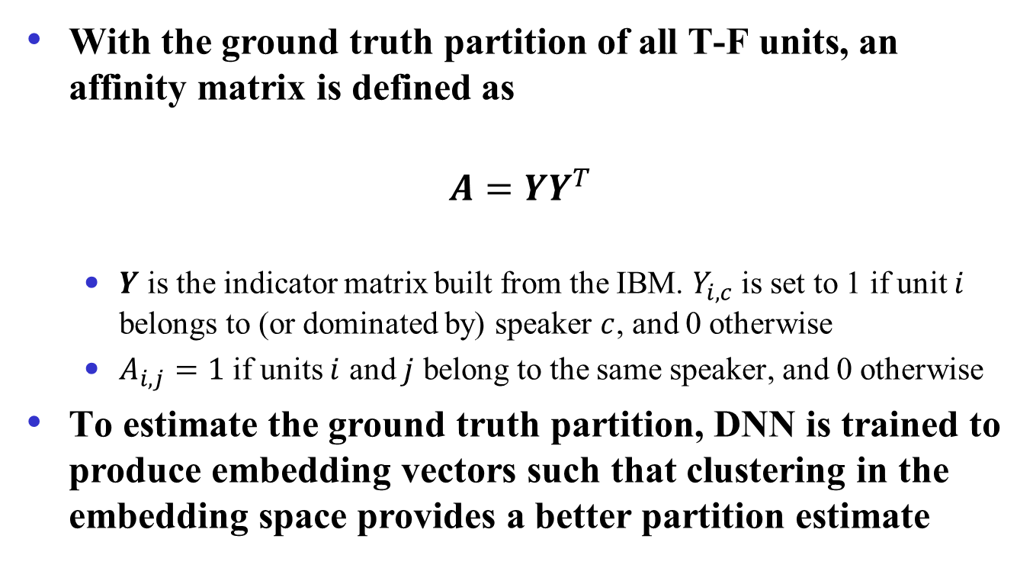
Deep clustering
With the ground truth partition of all T-F units, an affinity matrix is defined as
$$A=YY^{T}$$
$Y$ is the indicator matrix built from the IBM. $Y_{i, c}$ is set to 1 if unit $i$ belongs to (or dominated by) speaker $c$, and 0 otherwise
$A_{i, j}=1$ if units $i$ and $j$ belong to the same speaker, and 0 otherwise
To estimate the ground truth partition, DNN is trained to produce embedding vectors such that clustering in the embedding space provides a better partition estimate

Slide 55
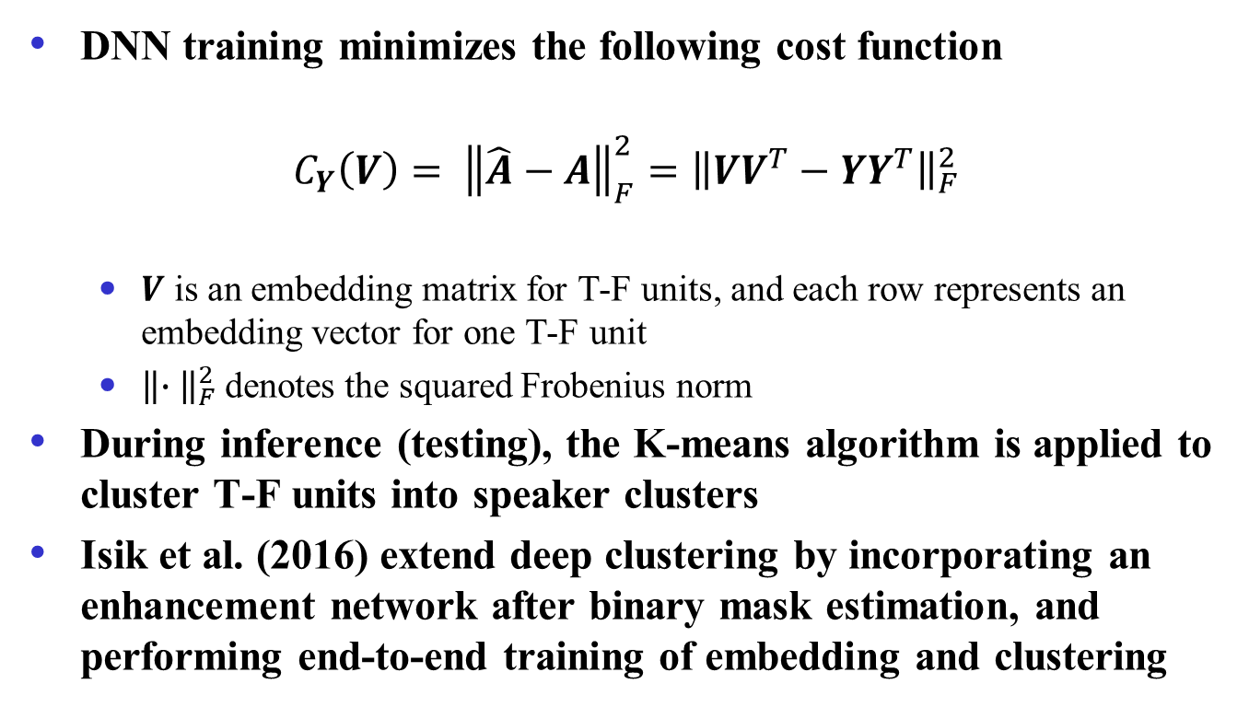
Deep clustering (cont.)
DNN training minimizes the following cost function
$$C_{Y}\left(V\right)= {\left\|\hat{A}−A\right\|}_{F}^{2}={\left\|VV^{T}−YY^{T}\right\|}_{F}^{2}$$
$V$ is an embedding matrix for T-F units, and each row represents an embedding vector for one T-F unit
${\left\|∙ \right\|}_{F}^{2}$denotes the squared Frobenius norm
During inference (testing), the K-means algorithm is applied to cluster T-F units into speaker clusters
Isik et al. (2016) extend deep clustering by incorporating an enhancement network after binary mask estimation, and performing end-to-end training of embedding and clustering

Slide 56
Permutation invariant training (PIT)
Recognizing that talker-dependent separation ties each DNN output to a specific speaker (permutation variant), PIT seeks to untie DNN outputs from speakers in order to achieve talker independence (Kolbak et al.’17)
Specifically, for a pair of speakers, there are two possible assignments, each of which is associated with a mean squared error (MSE). The assignment with the lower MSE is chosen and the DNN is trained to minimize the corresponding MSE

Slide 57
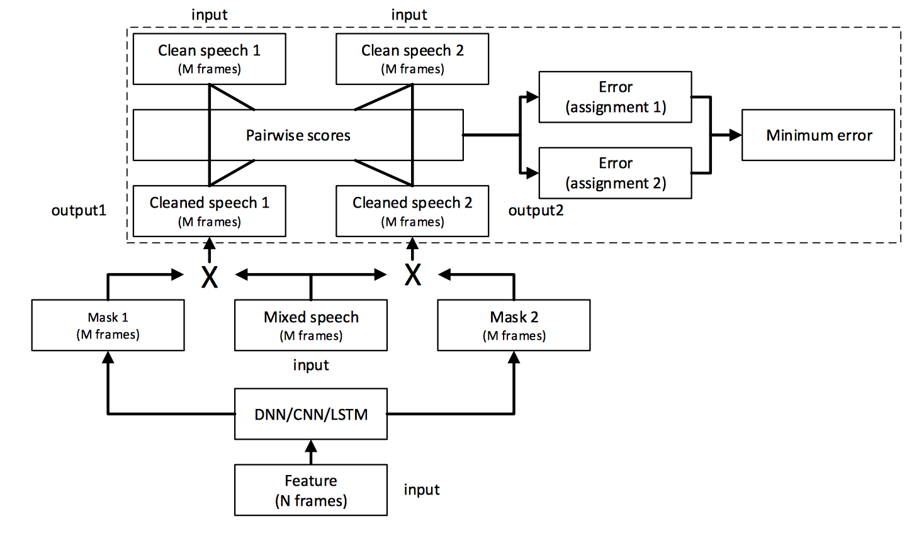
PIT illustration and versions
Frame-level PIT (tPIT): Permutation can vary from frame to frame, hence needs speaker tracing (sequential grouping) for speaker separation
Utterance-level PIT (uPIT): Permutation is fixed for a whole utterance, hence needs no speaker tracing

Slide 58
CASA based approach
Limitations of deep clustering and PIT
In deep clustering, embedding vectors for T-F units with similar energies from underlying speakers tend to be ambiguous
uPIT does not work as well as tPIT at the frame level, particularly for same-gender speakers, but tPIT requires speaker tracing
Speaker separation in CASA is talker-independent
CASA performs simultaneous (spectral) grouping first, and then sequential grouping across time
Liu & Wang (2018) proposed a CASA based approach by leveraging PIT and deep clustering
For simultaneous grouping, tPIT is trained to predict the spectra of underlying speakers at each frame
For sequential grouping, DNN is trained to predict embedding vectors for simultaneously grouped spectra

Slide 59
Sequential grouping in CASA
Differences from deep clustering
In deep clustering, DNN based embedding is done at the T-F unit level, whereas it is done at the frame level in CASA
Constrained K-means in CASA ensures that the simultaneously separated spectra of the same frame are assigned to different speakers

Slide 60
Speaker separation performance
Talker-independent separation produces high-quality speaker separation results, rivaling talker-dependent separation results
SDR improvements (in dB)

Slide 61

Talker-independent speaker separation demos
New pair of male-male speaker mixture
Speaker1 -uPIT
Speaker2 - uPIT
Speaker1 – DC++
Speaker2 – DC++
Speaker1 - CASA
Speaker2 - CASA
Speaker1 - clean
Speaker2 - clean

Slide 62
Part IV. Separation algorithms
Monaural separation
Speech-nonspeech separation
Speaker separation
Separation of reverberant speech
Multi-channel separation
Spatial feature based separation
Masking based beamforming
Notes:
62

Slide 63
Reverberation
Reverberation is everywhere
Reflections of the original source (direct sound) from various surfaces
Adverse effects on speech processing, especially when mixed with noise
Speech communication
Automatic speech recognition
Speaker identification
Previous work
Inverse filtering (Avendano & Hermansky’96; Wu & Wang’06)
Binary masking (Roman & Woodruff’13; Hazrati et al.’13)

Slide 64
DNN for speech dereverberation
Learning the inverse process (Han et al.’14)
DNN is trained to learn the mapping from the spectrum of reverberant speech to the spectrum of clean (anechoic) speech
Work equally well in spectrogram and cochleagram
Straightforward extension to separate reverberant and noisy speech (Han et al.’15)

Slide 65
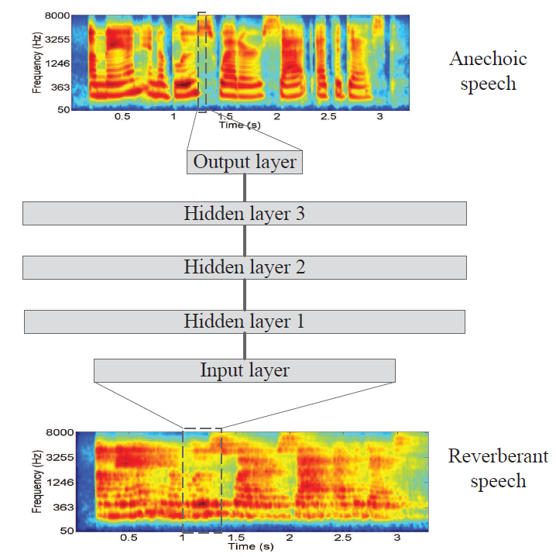
Learning spectral mapping
DNN
Rectified linear + sigmoid
Three hidden layers
Input: current frames + 5 neighboring frame on each side
Output: current frame

Slide 66
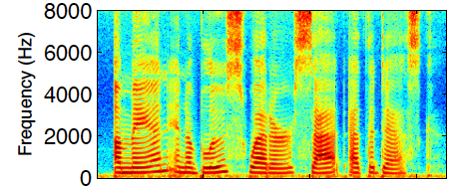
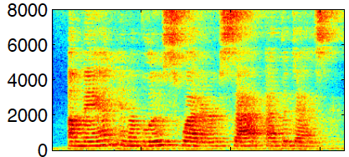
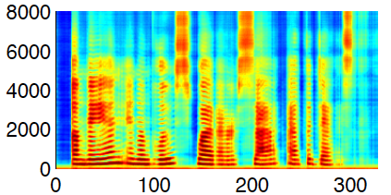
Dereverberation
Clean
Reverberant
(T₆₀ = 0.6 s)
Dereverberated

Slide 67
Two-stage model for reverberant speech enhancement
Noise and reverberation are different kinds of interference
Background noise is an additive signal to the target speech
Reverberation is a convolutive distortion of a speech signal by a room impulse response
Following this analysis, Zhao et al. (2017) proposed a two-stage model to address combined noise and reverberation

Slide 68
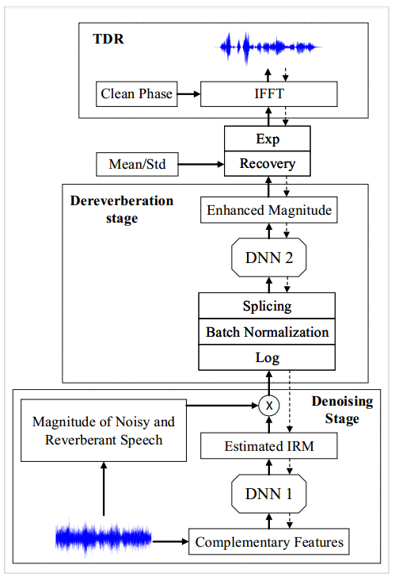
DNN architecture
The system has three modules:
Denoising module performs IRM estimation to remove noise from noisy-reverberant speech
Dereverberation module performs spectral mapping to estimate clean-anechoic speech
Time-domain signal reconstruction (TDR) module (Wang & Wang’15) performs time-domain optimization to improve magnitude spectrum estimation

Slide 69
Results and demo
Average across different reverberation times (0.3 s, 0.6 s, 0.9 s), different SNRs (-6 dB, 0 dB, 6 dB), and four noises (babble, SSN, DLIVING, PCAFETER)
Recent tests with hearing-impaired listeners show substantial intelligibility improvements
Demo (T60 = 0.6 s, babble noise at 3 dB SNR)
 | STOI (in %) | PESQ
unprocessed | 61.8 | 1.22
masking | 77.7 | 1.81
proposed | 82.6 | 2.08

Slide 70
Part IV. Separation algorithms
Monaural separation
Speech-nonspeech separation
Speaker separation
Separation of reverberant speech
Multi-channel separation
Spatial feature based separation
Masking based beamforming
Notes:
70

Slide 71
Binaural separation of reverberant speech
Speech separation has extensively used binaural cues
Localization, and then location-based separation
T-F masking for separation
Roman et al. (2003) proposed the first supervised method for binaural separation
DUET (Yilmaz & Richard’04) is the first unsupervised method

Slide 72
DNN based approach
Jiang et al. (2014) proposed DNN classification based on binaural features for reverberant speech separation
Interaural time difference (ITD) and interaural level difference (ILD)
Using binaural features to train a DNN classifier to estimate the IBM
Monaural GFCC features are also used
Systematic examination of generalization to different configurations and reverberation conditions

Slide 73
Training and test corpus
ROOMSIM is used with KEMAR dummy head
A library of binaural impulse responses (BIRs) is created with a room configuration: 6m×4m×3m
Three reverberant conditions with T₆₀: 0s, 0.3s and 0.7s
Seventy-two source azimuths
Azimuth angles from 0º to 355º, uniformly sampled at 5º, with distance fixed at 1.5m and elevation at zero degree
Target fixed at 0º
Number of sources: 2, 3 and 5
Target signals: TIMIT utterances
Interference: Babble
Training SNR is 0 dB (with reverberant target as signal)
Default test SNR is -5 dB

Slide 74
Generalization to untrained configurations
Two-source configuration with reverberation (0.3s T₆₀)
HIT stands for the hit rate (compared to the IBM) and FA for the false-alarm rate
With reasonable sampling of spatial configurations, DNN classifiers generalize well

Slide 75
Combining spatial and spectral analyses
Recently, Zhang & Wang (2017) used a more sophisticated set of spatial and spectral features
Separation is based on IRM estimation
Spectral features are extracted after fixed beamforming
Substantially outperforming conventional beamformers

Slide 76
Masking based beamforming
Beamforming as a spatial filter needs to know the target direction for steering purposes
Steering vector is typically supplied by direction-of-arrival (DOA) estimation of the target source, or source localization
However, sound localization in reverberant, multi-source environments itself is difficult
For human audition, localization depends on separation (Darwin’08)
A recent idea is to use monaural T-F masking to guide beamforming (Heymann et al.’16; Higuchi et al.’16)
Supervised masking helps to specify the target source
Masking also helps by suppressing interfering sound sources

Slide 77
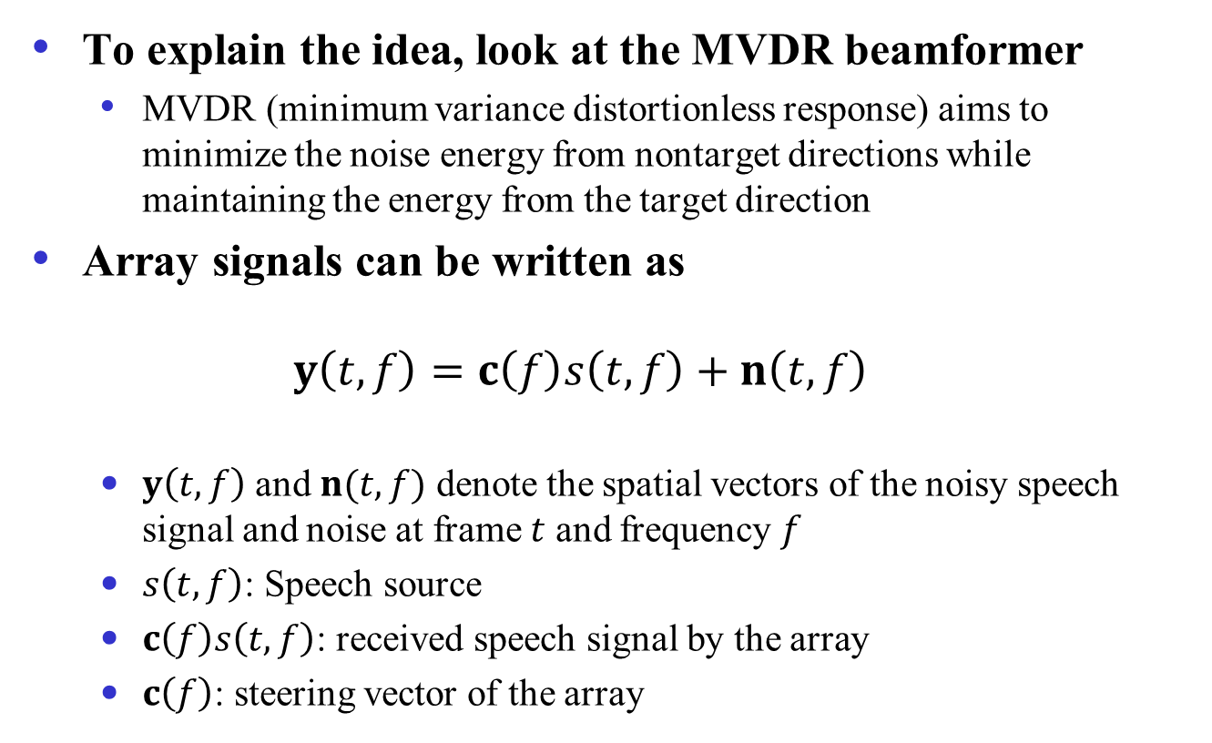
MVDR beamformer
To explain the idea, look at the MVDR beamformer
MVDR (minimum variance distortionless response) aims to minimize the noise energy from nontarget directions while maintaining the energy from the target direction
Array signals can be written as
$$y\left(t,f\right)=c\left(f\right)s\left(t,f\right)+n\left(t,f\right)$$
$y\left(t,f\right)$ and $n(t,f)$ denote the spatial vectors of the noisy speech signal and noise at frame $t$ and frequency $f$
$s\left(t,f\right)$: Speech source
$c\left(f\right)s\left(t,f\right)$: received speech signal by the array
$c\left(f\right)$: steering vector of the array

Slide 78
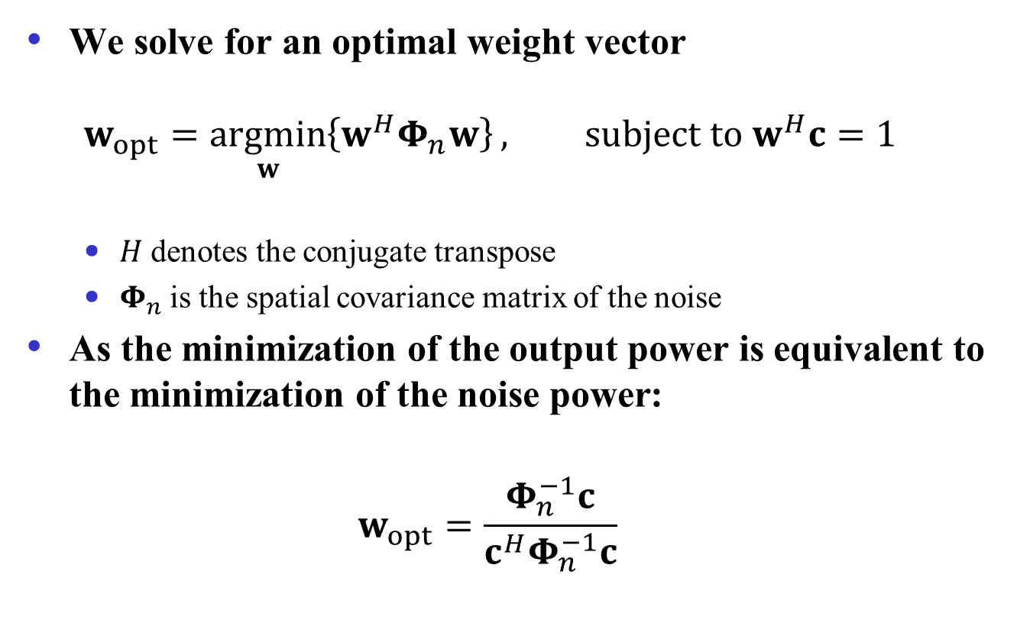
MVDR beamformer (cont.)
We solve for an optimal weight vector
$$w_{opt}=\underset{w}{argmin}\left\{w^{H}Φ_{n}w\right\}, subject to w^{H}c=1$$
$H$ denotes the conjugate transpose
$Φ_{n}$ is the spatial covariance matrix of the noise
As the minimization of the output power is equivalent to the minimization of the noise power:
$$w_{opt}=\frac{Φ_{n}^{−1}c}{c^{H}Φ_{n}^{−1}c}$$

Slide 79
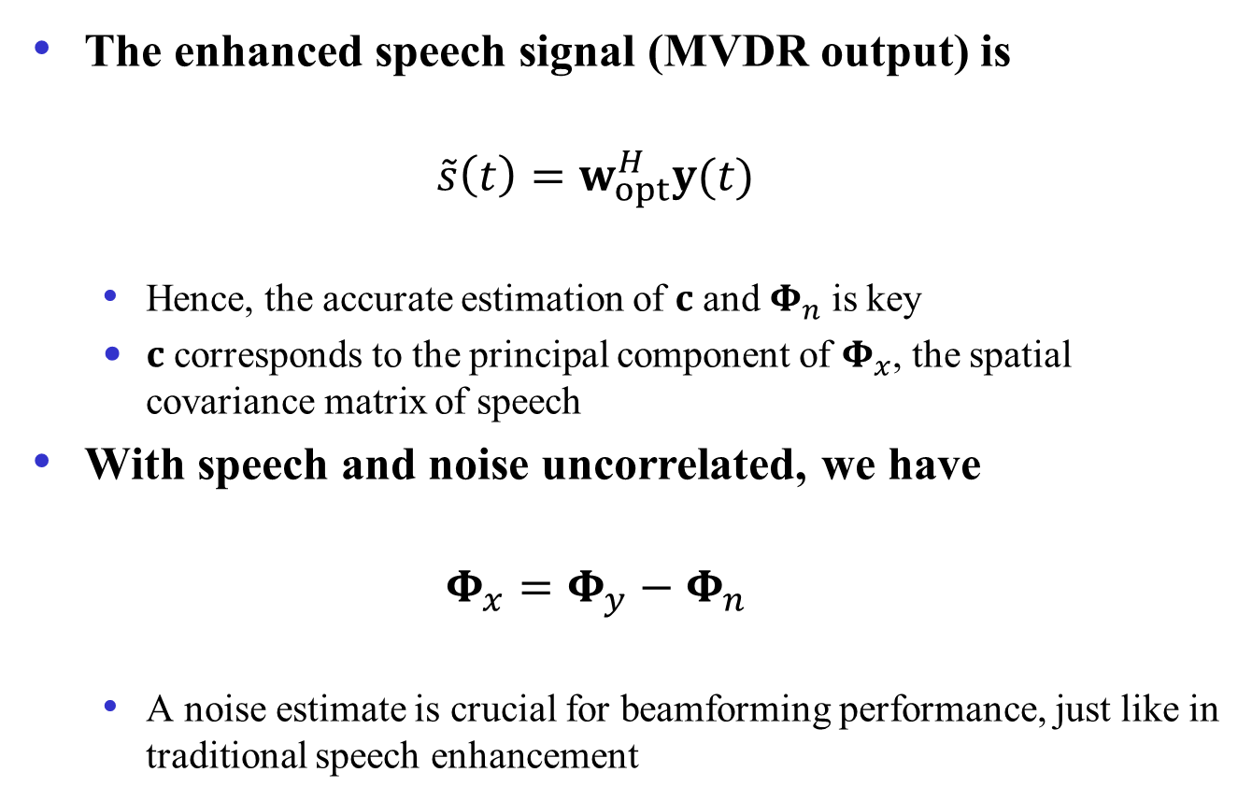
MVDR beamformer (cont.)
The enhanced speech signal (MVDR output) is
$$\tilde{s}\left(t\right)=w_{opt}^{H}y(t)$$
Hence, the accurate estimation of $c$ and $Φ_{n}$ is key
$c$ corresponds to the principal component of $Φ_{x}$, the spatial covariance matrix of speech
With speech and noise uncorrelated, we have
$$Φ_{x}=Φ_{y}−Φ_{n}$$
A noise estimate is crucial for beamforming performance, just like in traditional speech enhancement

Slide 80
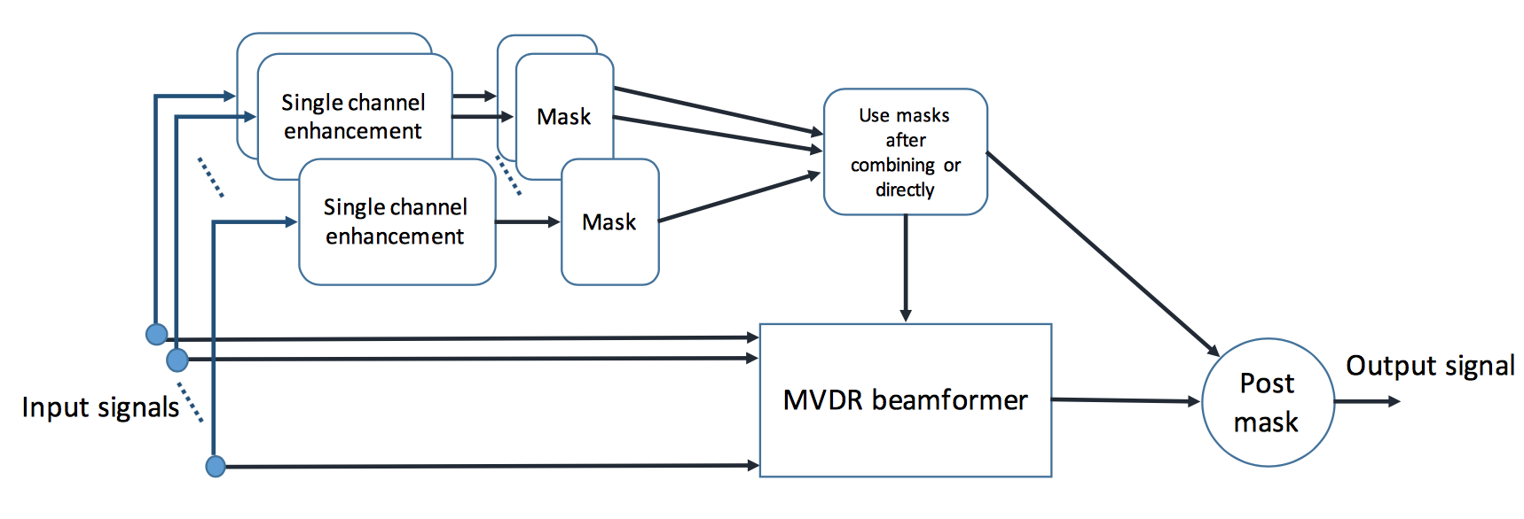
Masking based beamforming
A T-F mask provides a way to more accurately estimate noise (and speech) covariance matrix from noisy input
Heymann et al. (2016) use RNN with LSTM for monaural IBM estimation
Higuchi et al. (2016) compute a ratio mask using a spatial clustering method
From Erdogan et al. (2016)

Slide 81
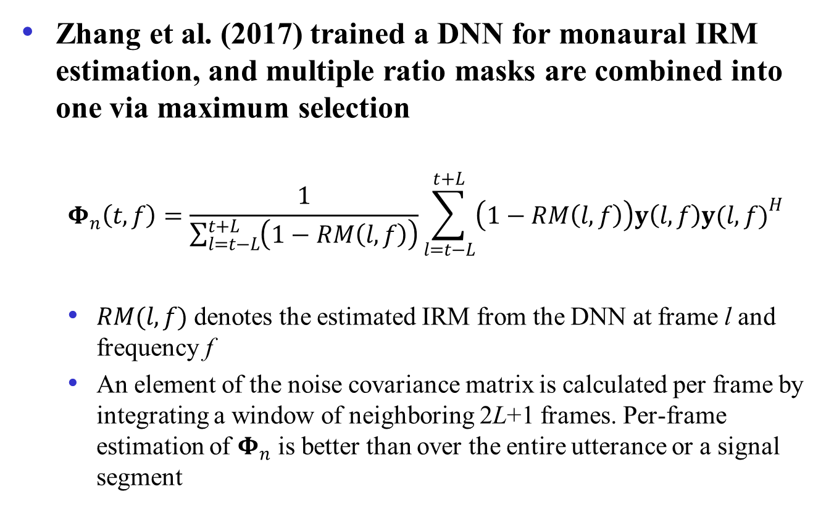
Masking based beamforming (cont.)
Zhang et al. (2017) trained a DNN for monaural IRM estimation, and multiple ratio masks are combined into one via maximum selection
$$Φ_{n}\left(t,f\right)=\frac{1}{\sum_{l=t−L}^{t+L}{\left(1−RM\left(l,f\right)\right)}}\sum_{l=t−L}^{t+L}{\left(1−RM\left(l,f\right)\right)y\left(l,f\right){y(l,f)}^{H}}$$
$RM(l,f)$ denotes the estimated IRM from the DNN at frame l and frequency f
An element of the noise covariance matrix is calculated per frame by integrating a window of neighboring 2L+1 frames. Per-frame estimation of $Φ_{n}$ is better than over the entire utterance or a signal segment

Slide 82
Masking based beamforming (cont.)
Masking based beamforming is responsible for impressive ASR results on CHiME-3 and CHiME-4 challenges
These results are much better than using traditional beamformers
Masking based beamforming represents a major advance in beamforming based separation and multi-channel ASR

Slide 83
Part V: Concluding remarks
Formulation of separation as classification, mask estimation, or spectral mapping enables the use of supervised learning
Advances in supervised speech separation in the last few years are truly impressive (Wang & Chen’18)
Large improvements over unprocessed noisy speech and related approaches
The first demonstrations of speech intelligibility improvement in noise
Elevation of beamforming performance

Slide 84
A solution in sight for cocktail party problem?
What does a solution to the cocktail party problem look like?
A system that achieves human auditory analysis performance in all listening situations (Wang & Brown’06)
An ASR system that matches the human speech recognition performance in all noisy environments
Dependency on ASR

Slide 85

A solution in sight (cont.)?
A speech separation system that helps hearing-impaired listeners to achieve the same level of speech intelligibility as normal-hearing listeners in all noisy environments
This is my current working definition – see my IEEE Spectrum cover story in March, 2017

Slide 86
Further remarks
Supervised speech processing is the mainstream
Signal processing provides an important domain for supervised learning, and it in turn benefits from rapid advances in machine learning
Use of supervised processing goes beyond speech separation and recognition
Multipitch tracking (Huang & Lee’13, Han & Wang’14)
Voice activity detection (Zhang et al.’13)
SNR estimation (Papadopoulos et al.’16)
Localization (Pertila & Cakir’17; Wang et al.’18)

Slide 87
Review of presentation
Introduction
Training targets
Features
Separation algorithms
Monaural separation
Speech-nonspeech separation
Speaker separation
Separation of reverberant speech
Multi-channel separation
Spatial feature based separation
Masking based beamforming
Concluding remarks

Slide 88
Resources and acknowledgments
This tutorial is based in part on the following overview
D.L. Wang & J. Chen (2018): “Supervised speech separation based on deep learning: An overview” IEEE/ACM T-ASLP, vol. 26, pp. 1702-1726
DNN Matlab toolbox for speech separation
http://www.cse.ohio-state.edu/pnl/DNN_toolbox
Source programs for some algorithms discussed in this tutorial are available at OSU Perception & Neurodynamics Lab’s website
http://www.cse.ohio-state.edu/pnl/software.html
Thanks to Jitong Chen, Donald Williamson, Yuzhou Liu, and Zhong-Qiu Wang for their assistance in the tutorial preparation

Slide 89
Cited literature and other readings
Ahmadi, Gross, & Sinex (2013) JASA 133: 1687-1692.
Anzalone et al. (2006) Ear & Hearing 27: 480-492.
Avendano & Hermansky (1996) ICSLP: 889-892.
Bach & Jordan (2006) JMLR 7: 1963-2001.
Bronkhorst & Plomp (1992) JASA 92: 3132-3139.
Brungart et al. (2006) JASA 120: 4007-4018.
Cao et al. (2011) JASA 129: 2227-2236.
Chen et al. (2014) IEEE/ACM T-ASLP 22: 1993-2002.
Chen et al. (2016) JASA 139: 2604-2612.
Cherry (1957) On Human Communication. Wiley.
Darwin (2008) Phil Trans Roy Soc B 363: 1011-1021.
Delfarah & Wang (2017) IEEE/ACM T-ASLP 25: 1085-1094.
Dillon (2012) Hearing Aids (2nd Ed). Boomerang.
Du et al. (2014) ICSP: 65-68.
Erdogan et al. (2015) ICASSP: 708-712.
Erdogan et al. (2016) Interspeech: 1981-1985.
Gonzales & Brookes (2014) ICASSP: 7029-7033.
Han et al. (2014) ICASSP: 4628-4632.
Han et al. (2015) IEEE/ACM T-ASLP 23: 982-992.
Han & Wang (2014) IEEE/ACM T-ASLP 22: 2158-2168.
Hazrati et al. (2013) JASA 133: 1607-1614.
Healy et al. (2013) JASA 134: 3029-3038.
Helmholtz (1863) On the Sensation of Tone. Dover.
Hendriks et al. (2010) ICASSP: 4266-4269.
Hershey et al. (2016) ICASSP: 31-35.
Heymann et al. (2016) ICASSP: 196-200.
Higuchi et al. (2016) ICASSP: 5210-5214.
Hu & Wang (2004) IEEE T-NN 15: 1135-1150.
Hu & Wang (2013) IEEE T-ASLP 21: 122-131.
Huang & Lee (2013) IEEE T-ASLP 21: 99-109.
Huang et al. (2014) ICASSP: 1581-1585.
Huang et al. (2015) IEEE/ACM T-ASLP 23: 2136-2147.
Hummersone et al. (2014) In Blind Source Separation, Springer.
Isik et al. (2016) Interspeech: 545-549.
Jiang et al. (2014) IEEE/ACM T-ASLP 22: 2112-2121.
Jin & Wang (2009) IEEE T-ASLP 17: 625-638.
Kim & Stern (2012) ICASSP: 4101-4104.
Kim et al. (2009) JASA 126: 1486-1494.

Slide 90
Cited literature and other readings (cont.)
Kjems et al. (2009) JASA 126: 1415-1426.
Kolbak et al. (2017) IEEE/ACM T-ASLP: 153-167.
Li & Loizou (2008) JASA 123: 1673-1682.
Li & Wang (2009) Speech Comm. 51: 230-239.
Liu & Wang (2018) ICASSP: 5399-5403.
Loizou & Kim (2011) IEEE T-ASLP 19: 47-56.
Lu et al. (2013) Interspeech: 555-559.
Narayanan & Wang (2013) ICASSP: 7092-7096.
Papadopoulos et al. (2016) IEEE/ACM T-ASLP 24: 2495-2506.
Pertila & Cekar (2017) ICASSP: 6125-6129.
Roman & Woodruff (2013) JASA 133: 1707-1717.
Roman et al. (2003) JASA 114: 2236-2252.
Shao et al. (2008) ICASSP: 1589-1592.
Srinivasan et al. (2006) Speech Comm. 48: 1486-1501.
Virtanen et al. (2013) IEEE T-ASLP 21: 2277-2289.
Wang (March 2017) IEEE Spectrum: 32-37.
Wang & Brown, Ed. (2006) Computational Auditory Scene Analysis. Wiley & IEEE Press.
Wang & Chen (2018) IEEE/ACM T-ASLP 26: 1702-1726.
Wang et al. (2008) JASA 124: 2303-2307.
Wang et al. (2009) JASA 125: 2336-2347.
WangY & Wang (2013) IEEE T-ASLP 21: 1381-1390.
WangY et al. (2013) IEEE T-ASLP 21: 270-279.
WangY et al. (2014) IEEE/ACM T-ASLP 22: 1849-1858.
WangY & Wang (2015) ICASSP: 4390-4394.
Wenninger et al. (2014) GlobalSIP MLASP Symp.
Williamson et al. (2016) IEEE/ACM T-ASLP 24: 483-492.
Wu & Wang (2006) IEEE T-ASLP 14: 774-784.
Xu et al. (2014) IEEE Sig. Proc. Lett. 21: 65-68.
Yilmaz & Rickard (2004) IEEE T-SP 52: 1830-1847.
Zhang & Wang (2016) IEEE/ACM T-ASLP 24: 967-977.
Zhang & Wang (2017) IEEE/ACM T-ASLP 25: 1075-1084.
Zhang et al. (2017) ICASSP: 276-280.
Zhang & Wu (2013) IEEE T-ASLP 21: 697-710.
Zhao et al. (2017) ICASSP: 5580-5584.

